Slide 1
What Is AI
Deep Learning
Lev Selector
February 12, 2021

Slide 2
Artificial General Intelligence (AGI)
AI that could successfully perform any intellectual task that a human can
(Turing test (1950), ...)
Artificial Intelligence (AI)
ML (DL) learning functions which are typically associated with human abilities (speech and music recognition, conversation, visual recognition, video prediction, reasoning, self-driving cars, playing games, etc.)
Deep Learning (DL)
ML implemented as Neural Network
Machine Learning (ML)
DS algorithm learns from data and makes predictions
Traditional Data Science (DS)
computer skills + statistics
CSV files, SQL, PowerPoint

Slide 3
AI in Context
Years
Artificial Intelligence (AI)
ML performing “human” functions
Deep Learning (DL)
ML implemented using multi-layered
structure (Neural Network)
Machine Learning (ML)
DS algorithm learns from data
Data Science (DS)
data + computer/statistics
Reinforcement Learning
alpha-Go
Unsupervised Learning
no labels, Google Translate
Supervised Learning
labeled data
Reasoning,
Inductive & Deductive Logic,
Knowledge Representation,
Ontology
2015
NLP,
Extracting Data from Text
2010
Chatbots,
Conversational
interfaces
Forecasting,
investments,
Resource Mgmnt
2005
Fraud Detection, Security,
Risk Mgmnt
2000
Recommender
Systems
Vision,
Robotics
Amount of data
Compute Speed

Slide 4
Recent breakthroughs in DL made it practical
(effective, affordable, and easy).
Instead of software engineers manually coding if/else logic,
DL algorithms can train networks equivalent to ~10s of million of if/else-s.
Distributed ML on Cloud (Google, Amazon, Mocrosoft, Intel, IBM, etc.)
allow to achieve ~100 Petaflops
(x1000 performance increase in last 3 years).
Prices dropping down precipitously: $6.50/hour per a Google TPU (180 TFlops).
You don't have to build your own infrastructure, you don't have to code from scratch. Nowadays you can use variety of pre-trained / pre-configured networks on the cloud. Compare this with just few years ago: custom HPC clusters (HPC = High-Performance Computing), low-level C/CUDA coding, etc.

Slide 5

“AI is the New Electricity”
AI like electricity will also change our lives in many ways which is difficult to predict.
Electricity came into our life ~120 years ago:
- lamps and motors - telegraph, telephone, radio, TV, Internet
- computers, IT, Machine Learning, AI
- finance, trading
- science, education, medical diagnostics
- automation, robotics,
- etc. etc.
Andrew Ng
- co-founded and led Google Brain
- was the chief scientist at Baidu Research (~1,300 people)
for 3 years (2014-2017), resigned in March of 2017.
- adjunct professor at Stanford University
- co-founder and chairman of Coursera
- https://en.wikipedia.org/wiki/Andrew_Ng
- https://www.coursera.org/learn/machine-learning
Artificial Intelligence is the New Electricity
- https://www.facebook.com/andrew.ng.96/videos/1268821713173733/ - https://www.youtube.com/watch?v=21EiKfQYZXc

Slide 6
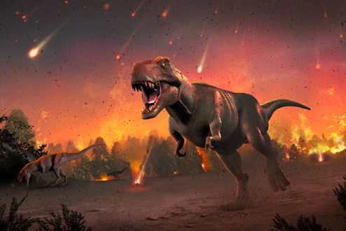
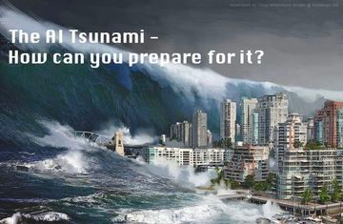
“AI is Life Extinction Event ?”
“AI - Tsunami ?”

Slide 7
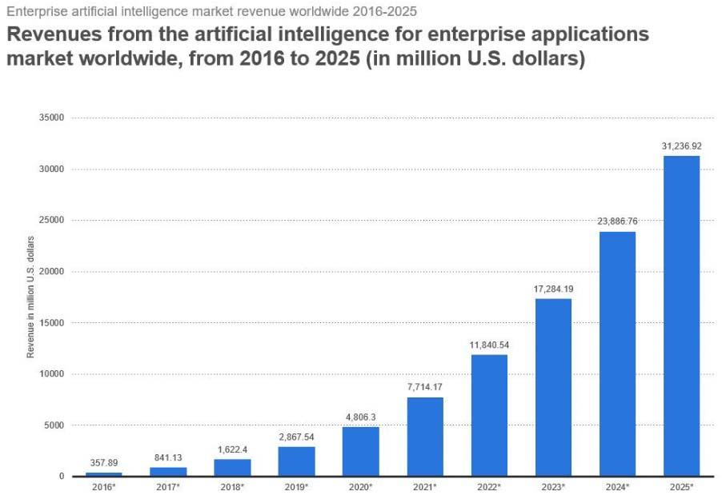
AI Growth Predictions
(Forbes, 2018)

Slide 8
Where and How ML & AI are used ?
ML = Machine Learning
AI = Artificial Intelligence
- predictions (news and trends, investments, elections, sport & weather, etc.)
- detection (fraud, crime, terrorism, climate change, etc.)
- self-driving cars (planes, boats, drones, construction/rescue machines, etc.)
- robots (at home & at work), manufacturing robots
- universal language translator, language understanding, concepts learning
- music & literature composition, games and math.
- medical diagnostics (using genomic, phenotypic, social, etc. data), surgery
- intelligent secretary/helper, process management, traffic management
- agriculture (pooling weeds, watering, etc.)
- toys, military
- combining AI with Virtual Reality and 3D printing
- effective interface with human brain, greatly expand their cognitive,
memory and sensory capabilities, uploading mind into computer
- etc. etc. etc.

Slide 9
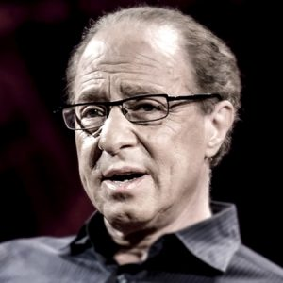

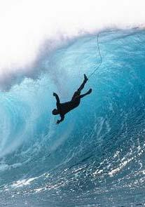
Ray Kurzweil, chief engineer for Google and famous futurist stated that "... ultimately, AI will benefit us in the same way that previous technologies have. ... My view is not that AI is going to displace us, ... (but) ... It’s going to enhance us. It does already.”
You need to get into AI asap to be able to surf the new wave, or this wave will drown you.
Millions of jobs will be "outsourced" to AI.
Also you will see new jobs, like "Chief AI Officer", AI departments.
We already see big shortage in AI specialists. Top AI talent is paid millions of $$.

Slide 10
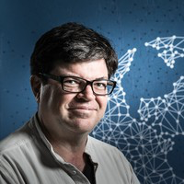
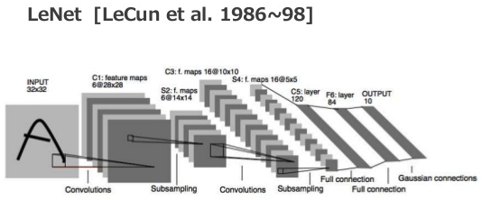
Yann LeCun (NYU, FB)
Credited with inventing Convolutional Neural Networks
in his 1998 paper on LeNets
https://www.youtube.com/watch?v=IbjF5VjniVE

Slide 11
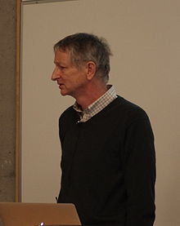
Three decades ago, Hinton was already making his mark on deep learning, co-inventing Boltzmann machines, backpropagation, and contrastive divergence.
But it wasn’t until the computing power managed to scale to meet the demands of deep learning that Hinton truly began to get the wider recognition outside of academia he deserved.
In 2004, he co-founded Neural Computation and Adaptive Perception, a handpicked, invite-only group of researchers from across the fields of physics, neuroscience and engineering.
He also founded DNNResearch, which was acquired by Google.
Since then, he’s been working on the Google “Brain” neural network project, and helping to dramatically improve Google’s image recognition and Android’s audio recognition capabilities.
Geoffrey Hinton
University of Toronto & Google
- https://en.wikipedia.org/wiki/Geoffrey_Hinton

Slide 12
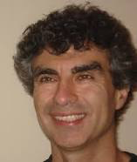
Yoshua Bengio
Full Professor, head of the Montreal Institute for Learning Algorithms. Most noted for his work on artificial neural networks and deep learning.
- https://en.wikipedia.org/wiki/Yoshua_Bengio
- http://www.iro.umontreal.ca/~bengioy/yoshua_en/
- https://scholar.google.com/citations?user=kukA0LcAAAAJ
Very good pictorial tutorial:
- http://www.iro.umontreal.ca/~bengioy/talks/DL-Tutorial-NIPS2015.pdf

Slide 13
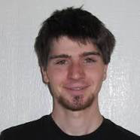
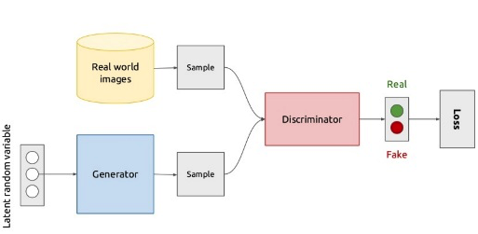
Ian Goodfellow
Staff Research Scientist at Google
Student of Yoshua Bengio.
https://en.wikipedia.org/wiki/Ian_Goodfellow
Generative Adversarial Nets (2014)
https://arxiv.org/pdf/1406.2661v1.pdf

Slide 14
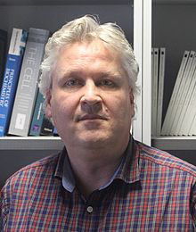
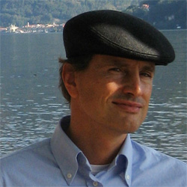
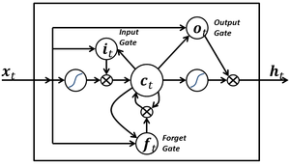
A simple LSTM block with only input, output, and forget gates. LSTM blocks may have more gates.
Sepp Hochreiter, Austria
- http://www.bioinf.jku.at/people/hochreiter/
Jürgen Schmidhuber, Switzerland
- http://people.idsia.ch/~juergen/
LSTM - Long short-term memory (1997)
Hochreiter, Sepp; and Schmidhuber, Jürgen; Long Short-Term Memory, Neural Computation, 9(8):1735–1780, 1997
https://en.wikipedia.org/wiki/Long_short-term_memory
Unlike traditional RNNs, an LSTM network is well-suited to learn from experience to classify, process and predict time series when there are time lags of unknown size and bound between important events.

Slide 15
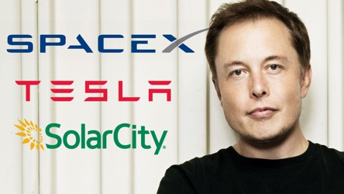

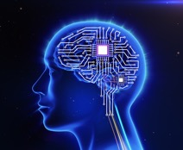
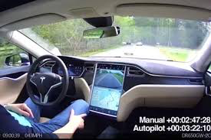

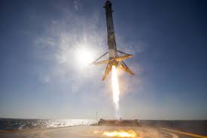
Elon Musk
PayPal
Tesla (self-driving electric cars)
SpaceX (Space ships
Open AI (open source AI)
Neurolink (integrate the human brain with AI – implantable interfaces)
Hyperloop - high-speed transportation system - reduced-pressure tubes, linear induction motors and air compressors.
The Boring Company – to dig tunnels.

Slide 16

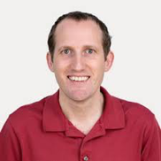
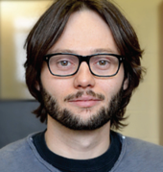
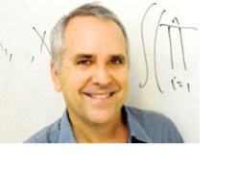
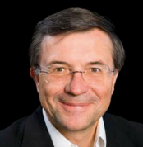
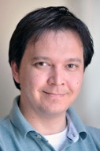
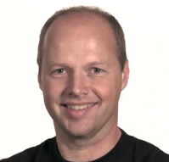
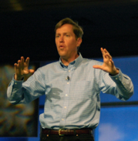
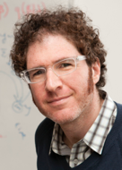
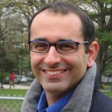
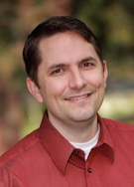
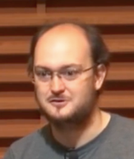



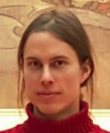
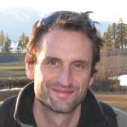

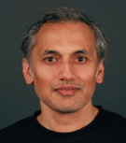
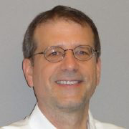
Andrej Karpathy
Vincent Vanhoucke
Hugo Larochelle
Michael I Jordan
Terry Sejnowski
Ruslan Salakhutdinov
Richard Socher
Sebastian Thrun
Jeffrey Hawkins
David M. Blei
Zoubin Ghahramani
Adam Coates
Pascal Lamblin
John Schulman
Alex Wiltschko
Tomas Mikolov
Alex Graves
Marc'Aurelio Ranzato
Shubho Sengupta
James D.
McCaffrey

Slide 17
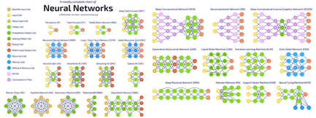
What is Deep Learning?
Do I need it?
“Deep Learning” are modern methods of creating Machine Learning Systems.
They use “Artificial Neural Networks”.
Machine Learning Systems = Prediction Machines.
Computers make computations cheap.
Computers make predictions practical – fast and cheap.

Slide 18
Recent breakthroughs in DL methods
made them practical
(effective, affordable, and easy).
Instead of software engineers manually coding if/else logic,
DL algorithms can train networks equivalent to millions or billions of if/else-s.
(Record of year 2020 – 175 Bln nodes).
Nowadays you can choose from a variety of pre-trained / pre-configured networks on the cloud.

Slide 19
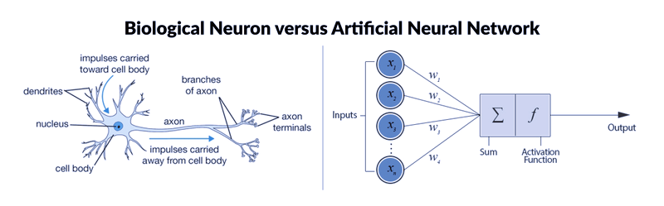
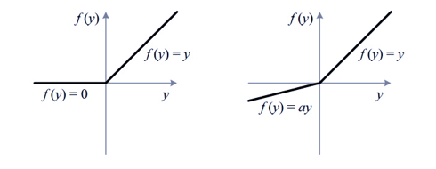
Deep Learning – models implemented as Neural Networks
Rectifier Leaky Rectifier
As neuron input grows, neuron activates (starts firing).
In NN it is modeled by "Activation Function".
Most commonly used function is "Rectifier".
ReLU = Rectified Linear Unit

Slide 20
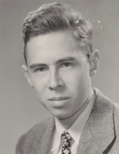
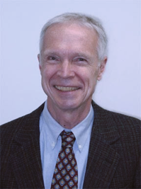
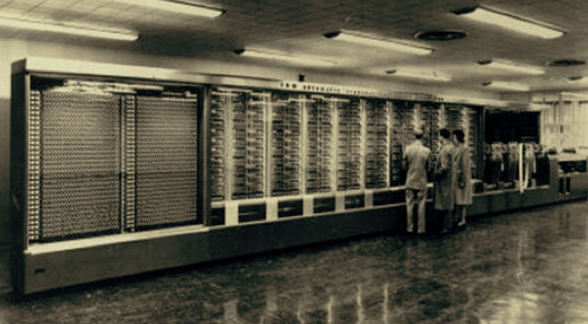
Frank Rosenblatt
(1928-1971)
Perceptron - 1957
Born in New Rochelle, New York Graduated from The Bronx High School of Science, then Cornell University BA 1950, Ph.D. 1956.
Worked at Cornell Aeronautical Laboratory in Buffalo, NY
Conducted the early work on perceptrons,
which culminated in the development and hardware construction of the Mark I Perceptron in 1960. This was essentially the first computer that could learn new skills by trial and error,
using a type of neural network that simulates human thought processes.
Single-Layer Network Perceptron. The machine was connected to a camera that used 20×20 cadmium sulfide photocells to produce a 400-pixel image. The main visible feature is a patchboard that allowed experimentation with different combinations of input features. To the right of that are arrays of potentiometers that implemented the adaptive weights

Slide 21
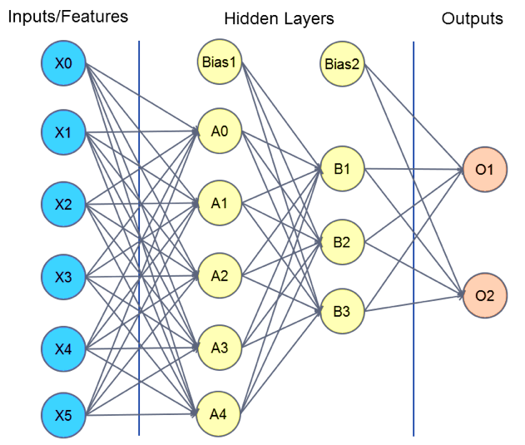
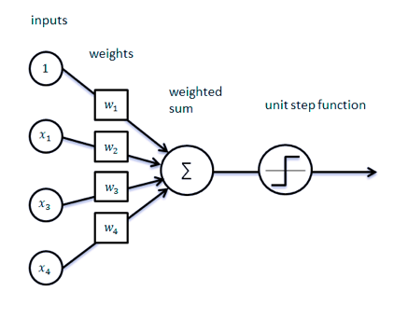
Perceptron
(Single Layer)
Multilayer Perceptron

Slide 22
Neural Networks Leverage “Multiplicative” Complexity
Chess board example:
1
2
4
8
…
N_{k} = 2*N_{k-1}
2⁶⁴ ~ 10¹⁹

Slide 23
Deep Learning – using layers to achieve “multiplicative” complexity
x
y = f(x)
If sequential layers are fully interconnected, then number of connections ~N*N*(L-1), and complexity ~ N^{L-1}, (N = size, L = number of layers). So if N=L=20, then Ncon =~ 8,000, Ncompl =~20¹⁹ =~ 5*10²⁴ .
Note: Logic is stored in weights of connections (W-coefficients), and biases (b-shifts). Note: we need non-linearity in nodes, otherwise the network is equivalent to a simple linear function.

Slide 24
Do you need to use Deep Learning?
If your data looks like a spreadsheet and you doing analytics – then you probably don’t need Deep Learning. You can use conventional Data Science methods.
But if you need to do more complex tasks, like converting speech to text, doing language translations, extracting information from text, controlling a robot or self-driving car, etc. – then you need Deep Learning methods.
Many of complex tasks were already solved and available for you
on major clouds (Google Translate, Azure Cognitive Services, etc.)

Slide 25
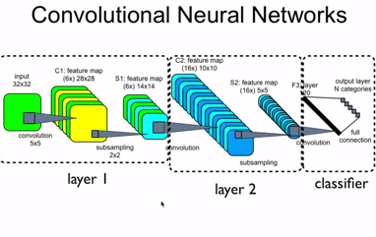
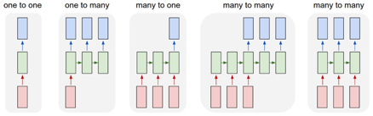

Examples of network architectures:
Feed-Forward Network
Deep Belief Network
(many layers of Restricted Boltzmann Machines (RBMs)
Convolutional Neural Network (CNN)
Recurrent Neural Network (RNN)
Autoencoders
Generative Adversarial Network (GAN)
Reinforcement Learning
Etc. Etc.

Slide 26


Question 1. C1 in the layer 1 has 6 feature maps, does that mean there are six convolutional kernels?
Each convolutional kernel is used to generate a feature map based on input.
There are 6 convolutional kernels and each is used to generate a feature map based on input.
Another way to say this is that there are 6 filters or 3D sets of weights.
What this image doesn't show, that it probably should, to make it clearer is that typically images have 3 channels, say red, green, and blue. So the weights that map you from the input to C1 are of shape/dimension 3x5x5 not just 5x5. The same 3 dimensional weights, or kernel, are applied across the entire 3x32x32 image to generate a 2 dimensional feature map in C1. There are 6 kernels (each 3x5x5) in this example so that makes 6 feature maps ( each 28x28 since the stride is 1 and padding is zero) in this example, each of which is the result of applying a 3x5x5 kernel across the input.
Question 2. S1 in layer 1 has 6 feature maps, C2 in layer 2 has 16 feature maps. What is the process look like to get these 16 feature maps based on 6 feature maps in S1?
Now do the same thing we did in layer one, but do it for layer 2, except this time the number of channels is not 3 (RGB) but 6, six for the number of feature maps/filters in S1. There are now 16 unique kernels each of shape/dimension 6x5x5. Each layer 2 kernel is applied across all of S1 to generate a 2D feature map in C2. This is done 16 times for each unique kernel in layer 2, all 16, to generate the 16 feature maps in layer 2 (each 10x10 since stride is 1 and padding is zero).
Yann LeCun (NYU, FB) 1998 paper on LeNets

Slide 27
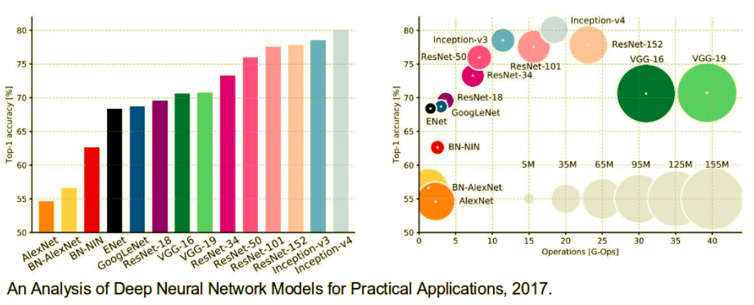
CNNs Architectures: LeNet, AlexNet, VGG, GoogLeNet, ResNet and more …
https://medium.com/@siddharthdas_32104/cnns-architectures-lenet-alexnet-vgg-googlenet-resnet-and-more-666091488df5

Slide 28
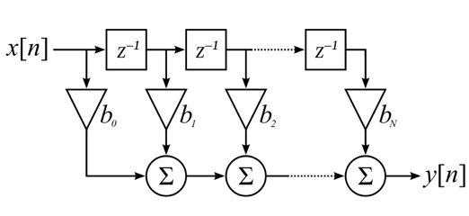
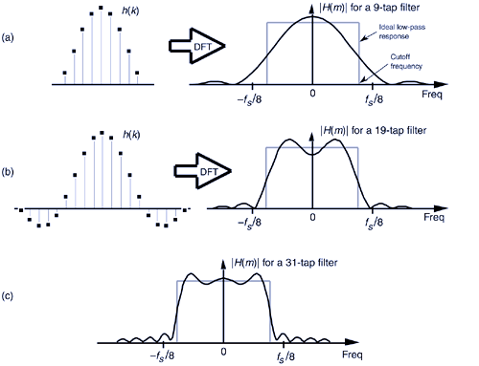
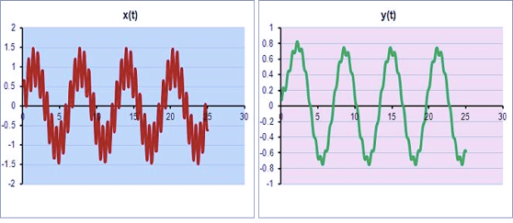
Signal Processing – Digital Filters.
Low-Pass Filter Design
Low-Pass Filtering

Slide 29
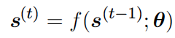

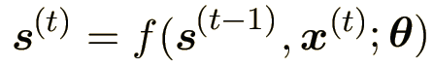
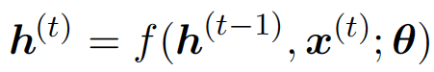

Unfolding Computational Graphs.
the idea of unfolding a recursive or recurrent computation into a computational graph that has a repetitive structure,
typically corresponding to a chain of events. For example:
Where ”state of the system” s(t) is a function of the previous state s(t-1)
Each node represents the state at some time t, and the function f() maps the state at time “t” to the state at time “t+1”.
Another example – same, but with additional external signal x(t):
Many recurrent neural networks use the above equation (or a similar equation) to define the values of their hidden units:
Example: the RNN is used to predict the next word given previous words. It may not be necessary to store all of the information in the input sequence up to time t, but rather only enough information to predict the rest of the sentence.

Slide 30


Autoencoders (AE)
Autoencoders (AE):
- feed-forward network
- create approximate copy
- dimensionality reduction (usually)
- feature learning
Can be trained as feedforward network with all of the same techniques, typically
minibatch gradient descent
following gradients computed by back-propagation.
Unlike general feedforward networks, autoencoders may also be trained using recirculation (Hinton and McClelland, 1988), a learning algorithm based on comparing the activations of the network on the original input to the activations on the reconstructed input.
x
h = f(x)
h
r = g(x)
r
Dimensionality reduction, feature learning
reconstruction

Slide 31



Autoencoder – denoising, correcting, gap filling

Slide 32

Variational Autoencoders (AE)

Slide 33
Generative Adversarial Networks (GANs)
Police Detective
(recognizes images)
Artistic Criminal
(generates fake images)
Both Detective and Criminal receive same set of images
(for example pictures of cats and dogs).
Criminal randomly generates “fake” images (cat with 6 legs and two tails, etc.).
Detective learns to discriminate real images from fakes and becomes better and better.
Criminal learns to make better and better fakes.
Adversarial relationship helps both of them become better fast.

Slide 34
LSTM
LSTM = Long Short-Term Memory
Imagine Recurrent Neural Network trying to recognize music sampled at 44KHz.
The 10 sec phrase will be 440,000 points. And when training – how we keep track of so many points going backwards?
This is the exploding or vanishing gradient problem.
Solution - instead of propagating analog gradients backwards,
we use "gates" (all or nothing).
A simple LSTM block with only input, output, and forget gates. LSTM blocks may have more gates.

Slide 35


Word2vec (Mikolov et al)
We construct numerical vectors to represent meaning (semantics) of words.
Main idea - a word can be described by its “neighbors” – a company this word has.
Similar words tend to have similar neighbors (word embeddings). Numerical vectors are constructed so that we can do vector arithmetic on them:
”king” – “he” + “she” ~ “queen”
Tomas
Mikolov

Slide 36



Ilya Sutskever
ilyasu@openai.com
Co-founder and Research Director of OpenAI.
Past: 3 years at Google Brain Team.
Co-author of AlexNet Co-founder of DNNresearch. a postdoc in Stanford with Andrew Ng's group. a student of Geoffrey Hinton, Toronto.
- https://blog.openai.com/evolution-strategies/ - (2017) Evolution Strategies (ES) – simpler and allow parallelization - thus better than Reinforcement Learning (RL)
Sequence to sequence learning

Slide 37


Alex Krizhevsky
- Convolutional network - Used GPUs - Used ReLUs - Used Drop Out to reduce ‘overfitting’ (DropOut).
Now at Google AlexNet – re-implemented LeNet on GPU (Toronto),
won 2012 ImageNet competition
“ImageNet Classification with Deep Convolutional Networks” - Alex Krizhevsky, Ilya Sutskever, and Geoffrey Hinton https://papers.nips.cc/paper/4824-imagenet-classification-with-deep-convolutional-neural-networks.pdf

Slide 38


ZF Net
The ILSVRC 2013 winner was a Convolutional Network
from Matthew Zeiler and Rob Fergus.
ZFNet (Zeiler & Fergus Net).
It was an improvement on AlexNet by tweaking the architecture hyperparameters,
in particular by expanding the size of the middle convolutional layers
and making the stride and filter size on the first layer smaller.
Matthew Zeiler
New York, clarifai - uses ML/DL for object recognition and search (ads, images, photo collections).
DL networks, Computer Vision, CS Ph.D. at NYU

Slide 39

GoogLeNet - 22 layer CNN and was the winner of ILSVRC 2014
http://www.cv-foundation.org/openaccess/content_cvpr_2015/papers/Szegedy_Going_Deeper_With_2015_CVPR_paper.pdf
Christian Szegedy, Wei Liu, Yangqing Jia, Pierre Sermanet, Scott Reed,
Dragomir Anguelov, Dumitru Erhan, Vincent Vanhoucke, Andrew Rabinovich
Inception module -> convolution and pooling in parallel.

Slide 40



(Deep) Reinforcement Learning
Generative models
AlphaGo playing with itself
Self-driving car driving in virtual world
Atari games
Demis Hassabis
Demis Hassabis CEO of Google DeepMind (>700 people). Co-founded DeepMind in 2010, sold it to Google in 2014.
Videogames designer, AI programmer
- http://demishassabis.com
- https://en.wikipedia.org/wiki/Demis_Hassabis
- 2013 – Atari games, reinforcement learning
- https://arxiv.org/pdf/1312.5602v1.pdf
- 2016 – AlphaGo (2017 – AlphaGo Zero)
- https://en.wikipedia.org/wiki/AlphaGo
AlphaGo

Slide 41


Quoc Le qvl@google.com
Google
GNMT (2016, Google Neural Machine Translation). Past: PhD Student – under Andrew Ng, Stanford
http://cs.stanford.edu/~quocle/ - papers, tutorials
https://arxiv.org/pdf/1609.08144v2.pdf - 31 authors deep LSTM network 8 encoder and 8 decoder layers parallelism - decreasing training time using attention and residual connections attention mechanism - connects the bottom layer of the decoder to the top layer of the encoder low-precision arithmetic for inference computations

Slide 42

Training Neural Networks
Forward propagation – from input to output (inference).
Error - compare output with label (desired output).
Back-propagation to adjust weights and biases to reduce error (Gradient Descent).
Learning = optimizing parameters (weights, biases, etc.) to find (local) minimum within multi-dimensional space.
Simulated annealing.
Absolute minimum is computationally difficult to find. Local minimum or saddle point is usually enough.
To find minimum we use SGD (Stochastic Gradient Descent) or mini-batch GD.

Slide 43
Training Neural Networks – slide 2
Hyper-parameters (number of layers, size of layers, etc.).
Learning rate.
Data sets: training set, dev. set, testing set
Overfitting – good results on training set, but not as good on testing set.
Regularization methods, dropout, early stopping, etc.

Slide 44
Training Neural Networks – slide 3
Layer-to-layer – matrix multiplications
Tensor – multi-dimensional matrix
Most common frameworks/libraries:
TensorFlow (Google)
pyTorch (Facebook)
Keras (on top of TF, etc.)
sklearn ( Scikit-Learn )
NLTK (Natural Language ToolKit)
Many others:
Theano (end of life), Lasagne (on top of Theano), Caffe, DSSTNE, mxnet, DL4J, CNTK (Cognitive Toolkit, Microsoft), ...

